Slide 1
16 KM Myths Debunked
Stan Garfield
November 5, 2015

Slide 2
16 KM Myths
Push it
Someone else will do it
KM is dead
Incentives don't work
Roll it out and drive adoption
Social is frivolous
Don't control
Eliminate risks
Be like Google and Amazon
We need our own
I don't have time
We should work ourselves out of a job
Bigger is better
Make people do it
Everything is a community
Our IP will be stolen

Slide 3
1. Push it
Publicize and advertise
Banner and spam
Lament too much email, but send out unwanted messages
Stop being so pushy; use the power of pull instead https://www.linkedin.com/pulse/stop-being-so-pushy-use-power-pull-instead-stan-garfield

Slide 4
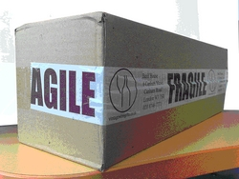
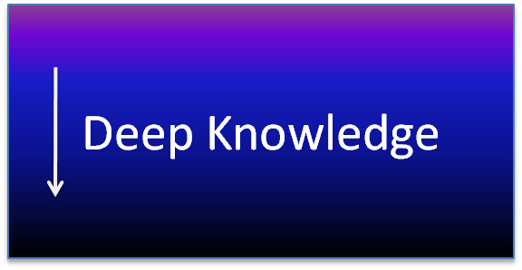
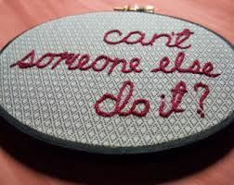
2. Someone else will do it
Leaders who initiate, then leave to others
KMers who don’t lead by example, don’t use tools being promoted to others, continue sending email, don’t experience what others are facing
Benchmark competitors rather than innovate
Avoid getting hands dirty, learning by doing, taking risks, speaking up, or acting
Some else will ask, someone else will contribute
Demand without supply
- Be agile, not fragile https://www.linkedin.com/pulse/agile-fragile-stan-garfield
- Can you lead without being the master of a domain?
https://www.linkedin.com/pulse/can-you-lead-without-being-master-domain-stan-garfield

Slide 5
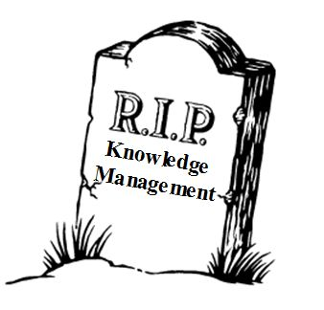
3. KM is dead
KM, email, social business, etc. are dead
Need a new name for KM
What is dead: focus on collection, document repositories, and web site visits
Is knowledge management on life support in most organizations?
https://www.linkedin.com/pulse/knowledge-management-life-support-most-organizations-stan-garfield

Slide 6
4. Incentives don't work
People will game the system!
That is not how people are motivated!
Incentives signal importance
Recognize and Reward for Desired Behaviors http://docs.google.com/View?id=ddj598qm_14dgnfv4cw

Slide 7
5. Roll it out and drive adoption
Roll out a tool
Everyone should collaborate!
One-time only special events
What are you supposed to do in a community? https://www.linkedin.com/pulse/what-you-supposed-do-community-stan-garfield

Slide 8
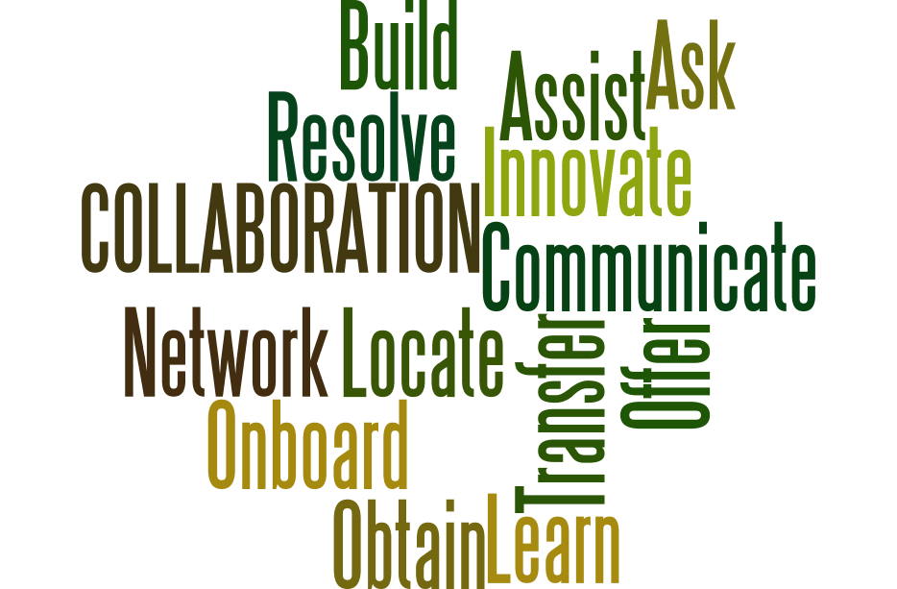
6. Social is frivolous
Not serious
I don’t care what you ate for breakfast
Wasting time
COLLABORATION Use Cases
https://www.linkedin.com/pulse/collaboration-use-cases-stan-garfield

Slide 9
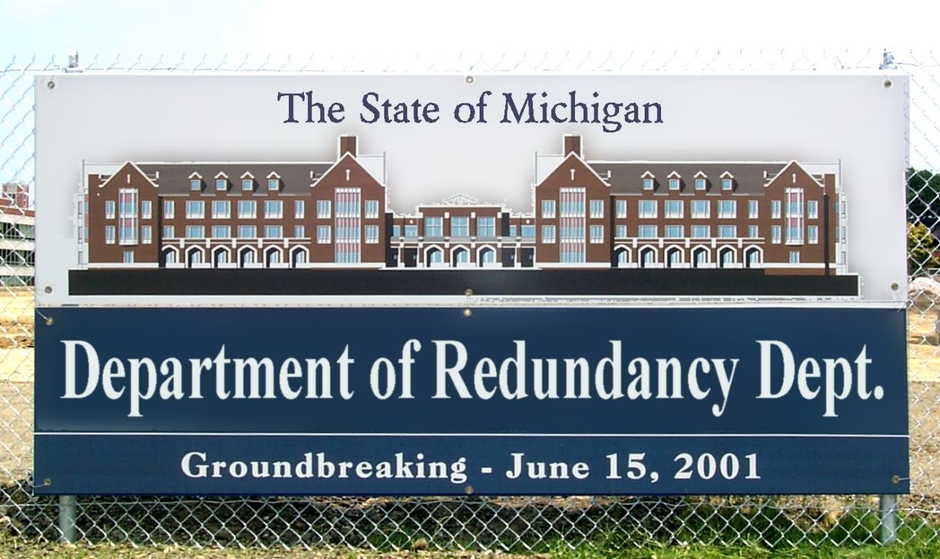
7. Don't control
Let a thousand flowers bloom – use survival of the fittest
Don’t try to control – rely on the wisdom of the crowd
Result: confusing lists of overlapping tags and communities
To control or not to: only you can prevent redundant communities https://www.linkedin.com/pulse/control-only-you-can-prevent-redundant-communities-stan-garfield

Slide 10
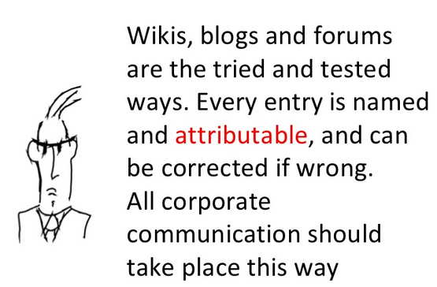
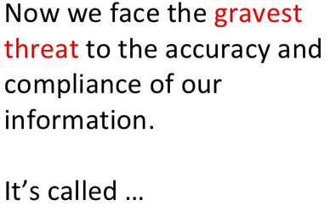
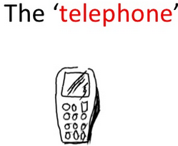
8. Eliminate risks
Visible versus invisible: email vs. ESN
Trust people to do no harm
Intervene when necessary
New technology - the threat to our information http://www.slideshare.net/normanlamont/new-technology-the-threat-to-our-information

Slide 11
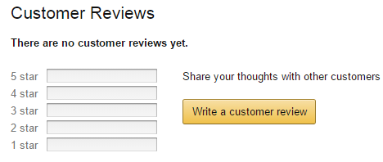
9. Be like Google and Amazon
Search like Google
Content ratings like Amazon
Behind the firewall is not the same scale as the Internet
Content rating is different behind the firewall than it is on the Internet http://docs.google.com/View?id=ddj598qm_34mr3vhsgx

Slide 12
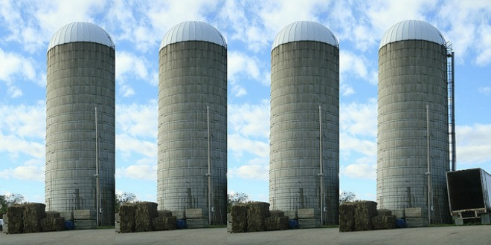
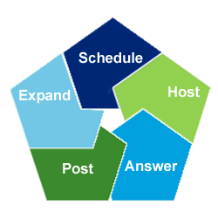
10. We need our own
Don’t practice what we preach – e.g., use private groups
Internal vs. external collaboration
Redundant, local, narrow niches: lack of critical mass
10 Tips for Leading Communities
https://www.linkedin.com/pulse/article/20141110202417-2500783-10-tips-for-leading-communities

Slide 13
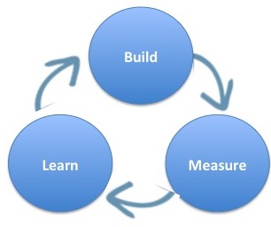
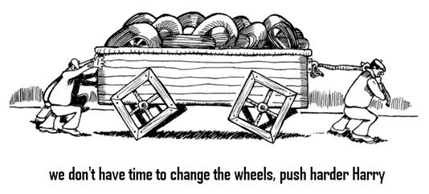
11. I don't have time
Don’t participate online, in calls, or at conferences
Don’t think that learning is as important as mundane tasks, endless meetings
Planning and prepping vs. trying things out and iterating
Implement, Improve, and Iterate http://docs.google.com/View?id=ddj598qm_21wpp22xz

Slide 14
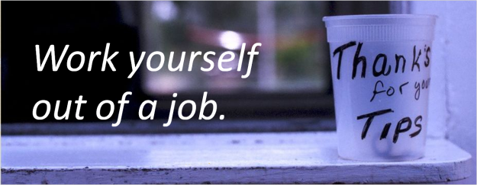
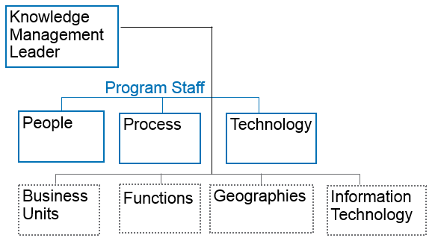
12. We should work ourselves out of a job
Integrate KM into work processes
KM is everyone’s job
What about Finance, HR, and Operations?
Knowledge Management Leaders & Community Managers: What's Needed? https://www.linkedin.com/pulse/knowledge-management-leaders-stan-garfield

Slide 15
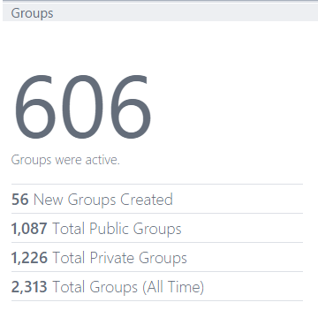
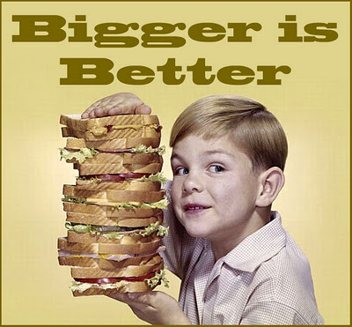
13. Bigger is better
Large teams, offshore resources
Dizzying web sites with animation and terrible user interfaces
Tout how many groups, pages, visits instead of value
Join-only members
Exception: more community members (not join-only) is better
Does Size Matter in Communities?
https://www.linkedin.com/pulse/20141208204832-2500783-does-size-matter-in-communities

Slide 16
14. Make people do it
Maintain expertise profiles
Contribute all documents
Forced membership
Everyone starts from one home page
How to Locate Expertise
https://www.linkedin.com/pulse/how-locate-expertise-stan-garfield

Slide 17
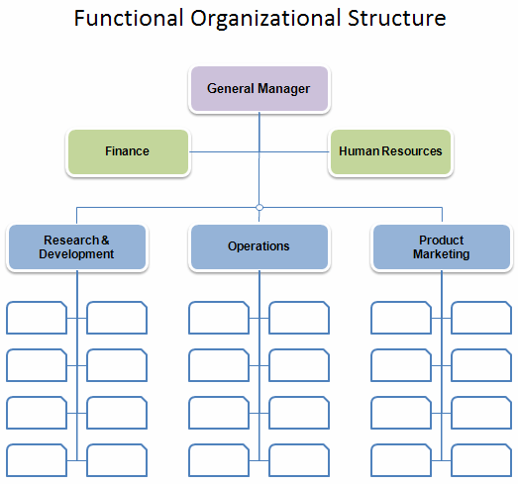
15. Everything is a community
Sites, wikis, blogs
Organizations, teams, companies
The entire Enterprise Social Network
Communities Manifesto http://docs.google.com/View?id=ddj598qm_44fx54rbg5

Slide 18
16. Our IP will be stolen
Another business unit
Competitors
Disgruntled employees
Open the gates and tear down the walls; moving from "need to know" to "need to share"
https://www.linkedin.com/pulse/open-gates-tear-down-walls-moving-from-need-know-share-stan-garfield

Slide 19
Questions for discussion
Have you observed some of these?
Do you have differing views?
What other myths would you like to debunk?

Slide 20
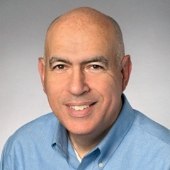
For additional information
Join the SIKM Leaders CoP http://tech.groups.yahoo.com/group/sikmleaders/
Twitter @stangarfield
Site http://sites.google.com/site/stangarfield/
Gaining Buy-in for KM (chapter author)
Stan Garfield
Implementing a Successful KM Program (author)
Successful Knowledge Leadership:
Principles and Practice
(chapter author) The Modern Knowledge Leader:
A Results-Oriented Approach

Slide 21
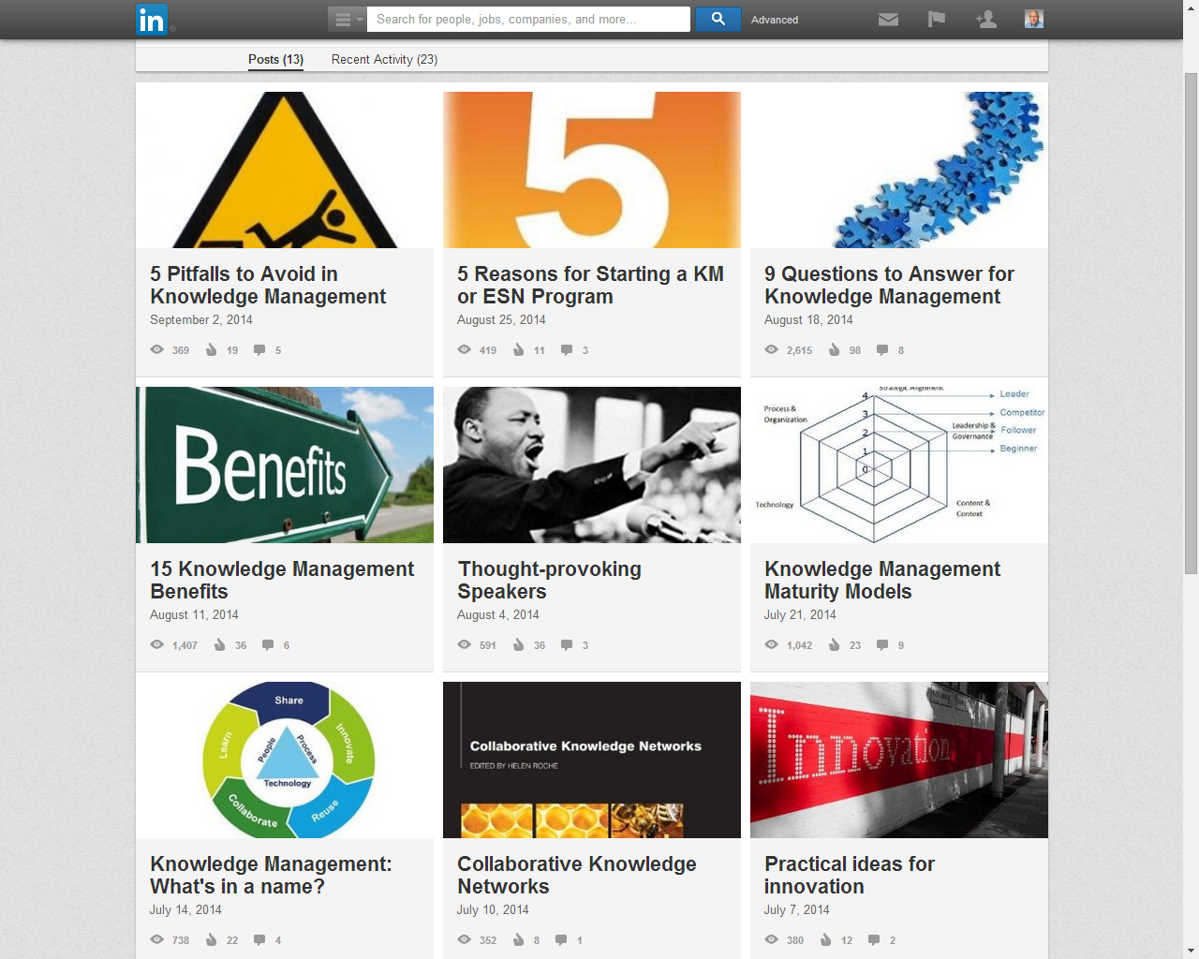
LinkedIn Posts https://www.linkedin.com/today/author/2500783

